Slide 1



Call for Code Challenge
Online shopping with minimum carbon footprint project
Team 1

Slide 2
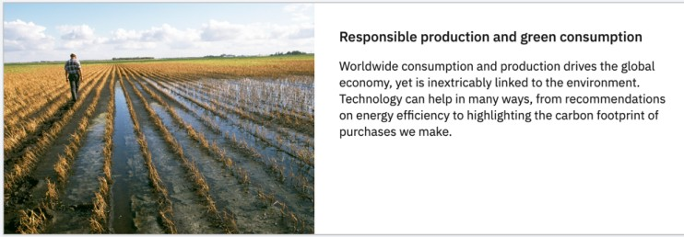


ESG - Challenge
Responsible consumption and distribution
Decarbonization in supply chain logistics
Urban freight in tier 1 and 2 cities has resulted in increased carbon footprint and reduced air quality
Wastage of perishable products
Losses to farmers, distributors and retailers

Slide 3

Responsible consumption and distribution
Supplier Accreditation -Carbon foot print
-ESG score
Failed Deliveries due to inaccurate addresses
Carbon emissions with each delivery
Geo route and their related carbon dioxide emissions
Depending on route of delivery, vehicle selection based on emissions levels
Packaging cost per delivery
User can select the supplier based on accreditation

Slide 4
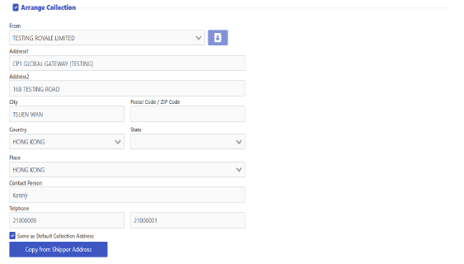
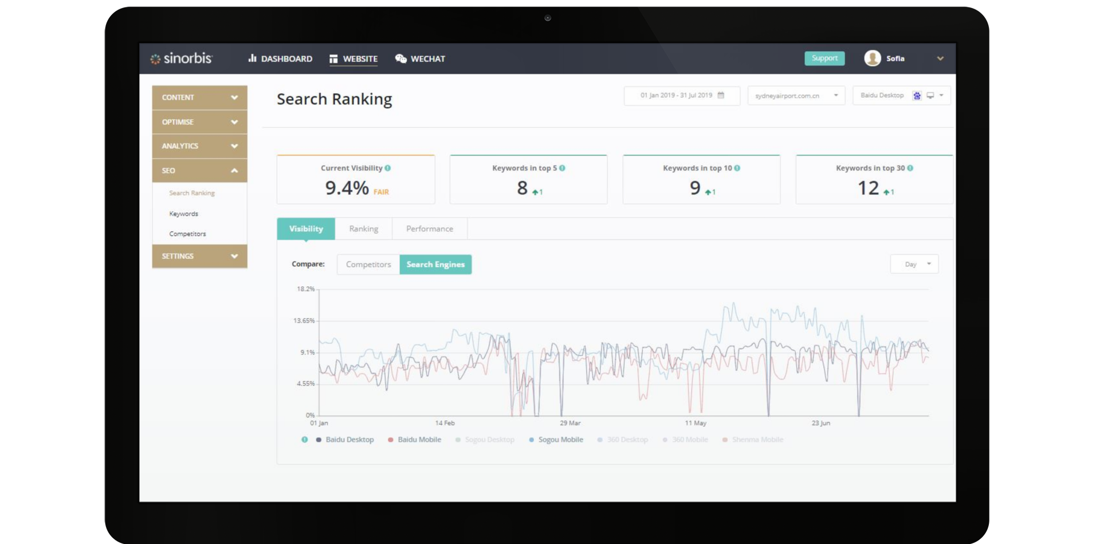
Wireframe
Illustration through an Enterprise Order Management System
Shipping options
DHL Express (Electric Vehicle)* Est. carbon footprint: 130kg Supplier ESG score: 10 Accreditations: 5
FedEx Est. carbon footprint: 427kg Supplier ESG score: 5 Accreditations: 2
Air Freight Est. carbon footprint: 640kg Supplier ESG score: 3 Accreditations: 1
*Recommended
Assumptions: 2,500km shipped and carbon footprint of travel per kilometer data

Slide 5






System Architecture
Dfjk;jlasdf
User
Third party logistic providers
Our Application
(Order Management System ESG Integration)
Get transportation details
Caching (Redis )
Caching (Redis )
IBM DB2 Database

Slide 6




Thank you!

